Slide 1

Tentative Agreement 2026-2028 FF/Capt/DFM/AFM Contract

Slide 2
Highlights to Proposed Contract
This PPT is not all inclusive of proposed changes, a complete explanation and specific language will be presented at the DEC Union Meeting.

Slide 3
Updates/New Contact Language
Wildland – Current MOU inclusion in CBA. No major substantive changes to current practice.
Court Leave/Jury Duty – Updated language and will more clearly outline Member/Admin responsibilities during court related or jury duty situations. Specific language still being crafted.
Drug/Alcohol Policy- contract language will state that Local/Admin will form a 6-person committee (3 each) to update and make amendments to current policy. Once policy is agreed upon, it will be inserted in current contract.

Slide 4
Education Incentive/Requirement
Current language states prospective Captains or AFMs are required to have at least 90 college quarter credits, 60 semester credits or an Associates Degree to be eligible to participate in a promotional exam process.
New Language states beginning Jan 1, 2026, prospective Captains or AFM can also qualify to participate in the promotional exam process by having (7) years of service with the VRFA.

Slide 5
Sick Leave
Increasing Sick Leave accrual to 18hrs for 24hr shift members, 10hrs for day staff.
Discontinue the current 2000hr Admin sponsored Emergency Sick Leave bank.
Creation of a 500hr Local sponsored Emergency Sick Leave bank.
Bank will follow the same rules for using the bank as the current contract language.
Bank will be created with 500hrs of Members sick leave (app. 4hrs/member) on Jan 1, 2026.
Bank will be resupplied with member sick leave each year on Jan 1 if the bank balance drops below 500hrs.

Slide 6

Holiday Leave/Vacation Leave
Day Staff members – Christmas Eve will be added to observed holidays.
Vacation sellback language will be updated to read “Day Staff Vacation Sellback”, vacation sellback will be for Day Staff members only.
24hr shift members – switching from VAC sellback to Holiday sellback.
# of Holidays available for sellback will follow be the same as currently available for VAC sellback (seniority scale).
24hr shift members no longer able to sellback VAC
Monies accrued via Holiday sellback are considered pensionable.

Slide 7
Wages
2026 – Increase base wage by 7%
2027 - Increase base wage by 7%
2028 - Increase base wage by 7%

Slide 8
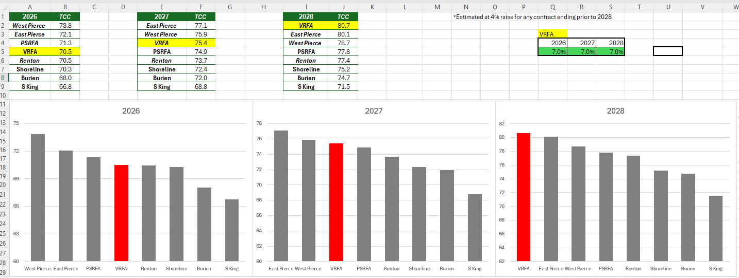
TCC Comparisons/Projections

Slide 9
Questions?
Please attend DEC Union Meeting for a detailed presentation on the proposed contract
Current timeline should have a red-lined contract posted following the DEC Union Meeting
For any questions, please contact any member of the Negotiations Team
Ryan Connell
Ryan Freed
Aaron Lewis
Andrew O’Donnell
Johan Friis
Alex Hough

